Slide 1
Ensemble Methods in Machine Learning
Technical Seminar
by
SAI DISHA .D
231057026
ME in Artificial Intelligence & Machine Learning
Under the guidance of
Panel Member 1: | Panel Member 2:
Dr. Keerthana Prasad | Mr. Balaji .B
Professor & Director | Assistant Professor
Manipal School of Information Sciences | Manipal School of Information Sciences
MAHE, Manipal | MAHE, Manipal

Slide 2
Presentation Outline
Introduction to Ensembles Methods
2. Why Ensembles?
3. Types of Ensemble Methods
4. Bagging
5. Random Forests
6. Boosting
7. Stacking
8. Cascading
9. Applications
10. Conclusion
References

Slide 3
1. Introduction
Ensemble: combines predictions from multiple ML algorithms together (base models).
Weak learners used.
Weak learners with accuracy better than chance 50%.
Harnessing the concept "wisdom of crowd" in machine learning.
Musical Orchestra Analogy.
Key aspect: The more different these models are, the better the combination.

Slide 4
2. Why Ensembles ?
Improve Robustness: By reducing the spread in predictions made by the model.
Improve overall accuracy of predictions.
Balancing act: It strikes a balance between bias and variance. Reduce model error.
Model Error = Bias² + Variance

Slide 5
3. TYPES OF ENSEMBLES
These are some prominent Ensemble approaches:
Bagging (Bootstrapped Aggregation)
Boosting
Stacking Classifier
Cascading Classifier

Slide 6
4. Bagging
Each model is trained using a separate subset of training data, referred to as "bootstrap samples".
These are created by sampling with replacement.
For a classification problem, the majority vote of base learners is required.
The mean of predictions is computed for a regression problem.
Also referred to as "Bootstrapped Aggregation".

Slide 7
5. Out of Bag Evaluation
Out of bag (OOB) instances are training cases that have not been sampled.
OOB error
1. Find all models not trained by an OOB instance
2. Take majority vote of the models' predictions for the OOB instance.
3. Average of errors for an instance gives OOB error for that instance.
4. Compile error of all instances in OOB dataset.

Slide 8
5. Random Forests
Base Learners: Decision Trees of reasonable depth.
Generally, trained with bagging method.
These decision trees are low bias and high variance models.
Random Forests = Multiple Decision Trees with (Row sampling with replacement + Column Sampling + Aggregation).

Slide 9
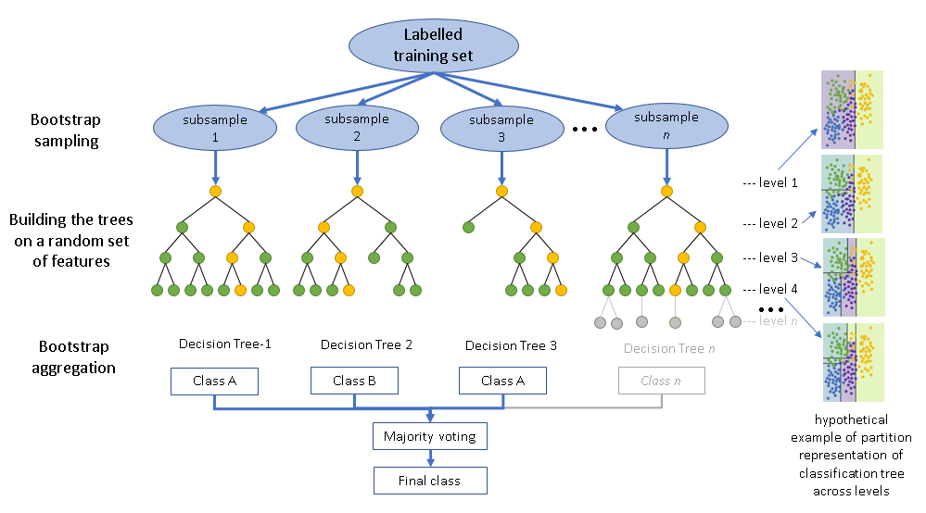
5. Random Forests

Slide 10
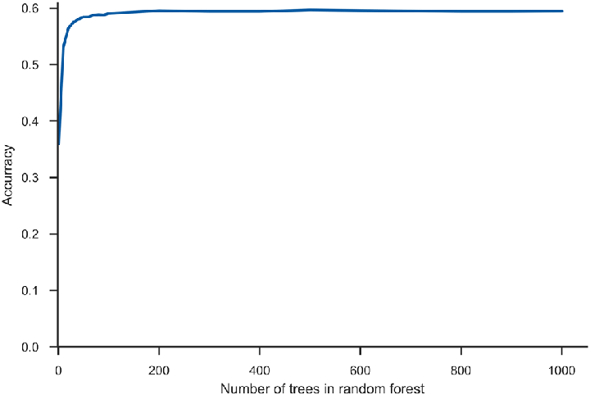
5. Random Forests
Find best k by plotting accuracy.
In multi-core system, run time complexity is O(depth * k)
Space complexity O(space occupied by 1 DT * k)

Slide 11
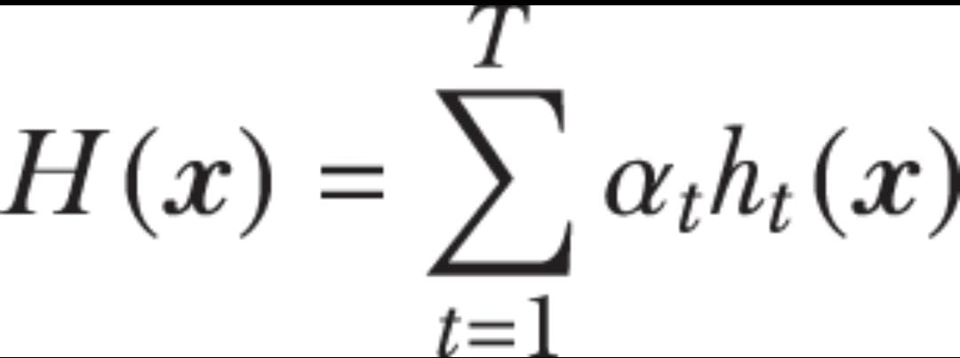
6. Boosting
CORE IDEA:
Consider D_{train} = {x_{i,} y_{i}} for all 'n' samples.
M₀ trained on D_{train} has error_{i} = y_{i}-h_{o}(x_{i}).
Model M1 trained on {x_{i}, error_{i}} for all n samples.
At the end of stage 1, we have weighted sum of 2 base models
H₁(x) = α₀h₀(x) + α₁h₁(x)
Similarly at end of stage T, we have the model as below:

Slide 12
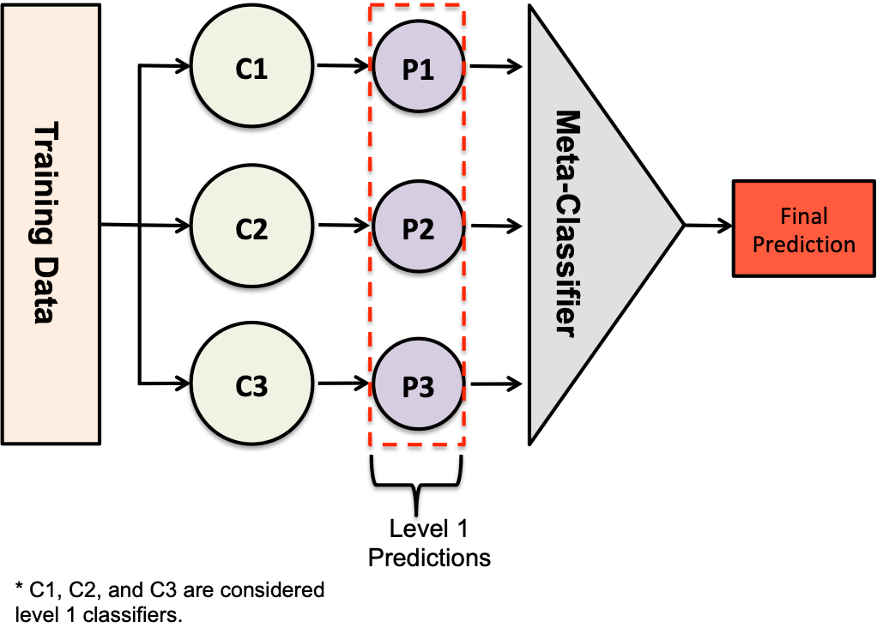
7. Stacking
All the base models are built and trained in parallel.
A query point passed through all models
Final model called meta classifier is built on top of these models
Seldom used in real world

Slide 13
8. Cascading
Consists of a sequence of stages, each with a classifier.
Example, Credit Card Transaction.
In the initial stages, simpler and faster classifiers are employed to quickly filter out obvious cases.
As the cascade progresses, the complexity of classifiers increases to handle more challenging cases.
The entire dataset is passed through the cascade, but only instances not classified with 100% assurance in each stage proceed to the next stage.

Slide 14
9. Application
Kaggle competitions.
Classification and Regression problems.
Recommendation Systems.
Customer Churn Prediction.
Healthcare etc.
They have wide range of applications.

Slide 15
10. Conclusion
As we wrap up our discussion on ensemble models, remember that choosing the right ensemble technique and understanding your data are keys to achieving superior results in various real-world applications.

Slide 16
References
[1] Omer Sagi and Lior Rokach, “Ensemble learning: A survey,” WIRE data mining and knowledge discovery, Accepted: 23 January 2018.
[2] Thomas G. Dietterich, "Ensemble Methods in Machine Learning", Oregon State University, Corvallis, Oregon, USA.
[3] Gautam Kunapuli, Ensemble Methods in Machine Learning, Manning publications.

Slide 17
Queries
&
Suggestions

Slide 18
THANK YOU…

